Slide 1
PLAN MANAGEMENT ADVISORY GROUP MEETING
August 9, 2018

Slide 2
WELCOME AND AGENDA REVIEW
ROB SPECTOR, CHAIR
PLAN MANAGEMENT ADVISORY GROUP

Slide 3
AGENDA
AGENDA
Plan Management and Delivery System Reform Advisory Group
Meeting and Webinar
Thursday, August 9, 2018, 10:30 a.m. to 12:30 p.m.
August Agenda Items Suggested Time
Welcome and Agenda Review 10:30 - 10:35 (5 min.)
2019 Rates and Offerings 10:35 - 10:50 (15 min.)
Covered California Personnel & Strategy Update 10:50 - 11:20 (30 min.)
Dental Intern Research: Provider Quality and Risk Assessment 11:20 – 11:35 (15 min.)
Plan Advisory Scope and Work Group Focus Areas 11:35 – 12:20 (45 min.)
Open Forum 12:20 – 12:30 (10 min.)

Slide 4
2019 Rates and offerings
JAMES DEBENEDETTI, DIRECTOR
PLAN MANAGEMENT DIVISION

Slide 5
2019 RATES AND OFFERINGS UPDATE
All 11 health insurance companies will return in 2019.
96 percent of consumers will be able to choose from two insurers or more and 82 percent of consumers will have three or more choices.
Average weighted rate change is 8.7 percent if all enrollees renewed into the same plan.
  Loss of individual mandate penalty caused issuers to add between 2.5 and 6 percentage points to the rate increase, with an average of 3.5 percent, due to concerns that the penalty removal will lead to a less healthy/more costly consumer pool.
  Federal suspension of the annual health insurer tax helped lower rates by approximately 1.6 percent. Tax is scheduled to return in 2020.
  The average rate change for consumers who shop and switch to the lowest-cost plan in the same metal tier is -0.7 percent. Many consumers can pay the same rate they do now in 2018, or a little less.

Slide 6
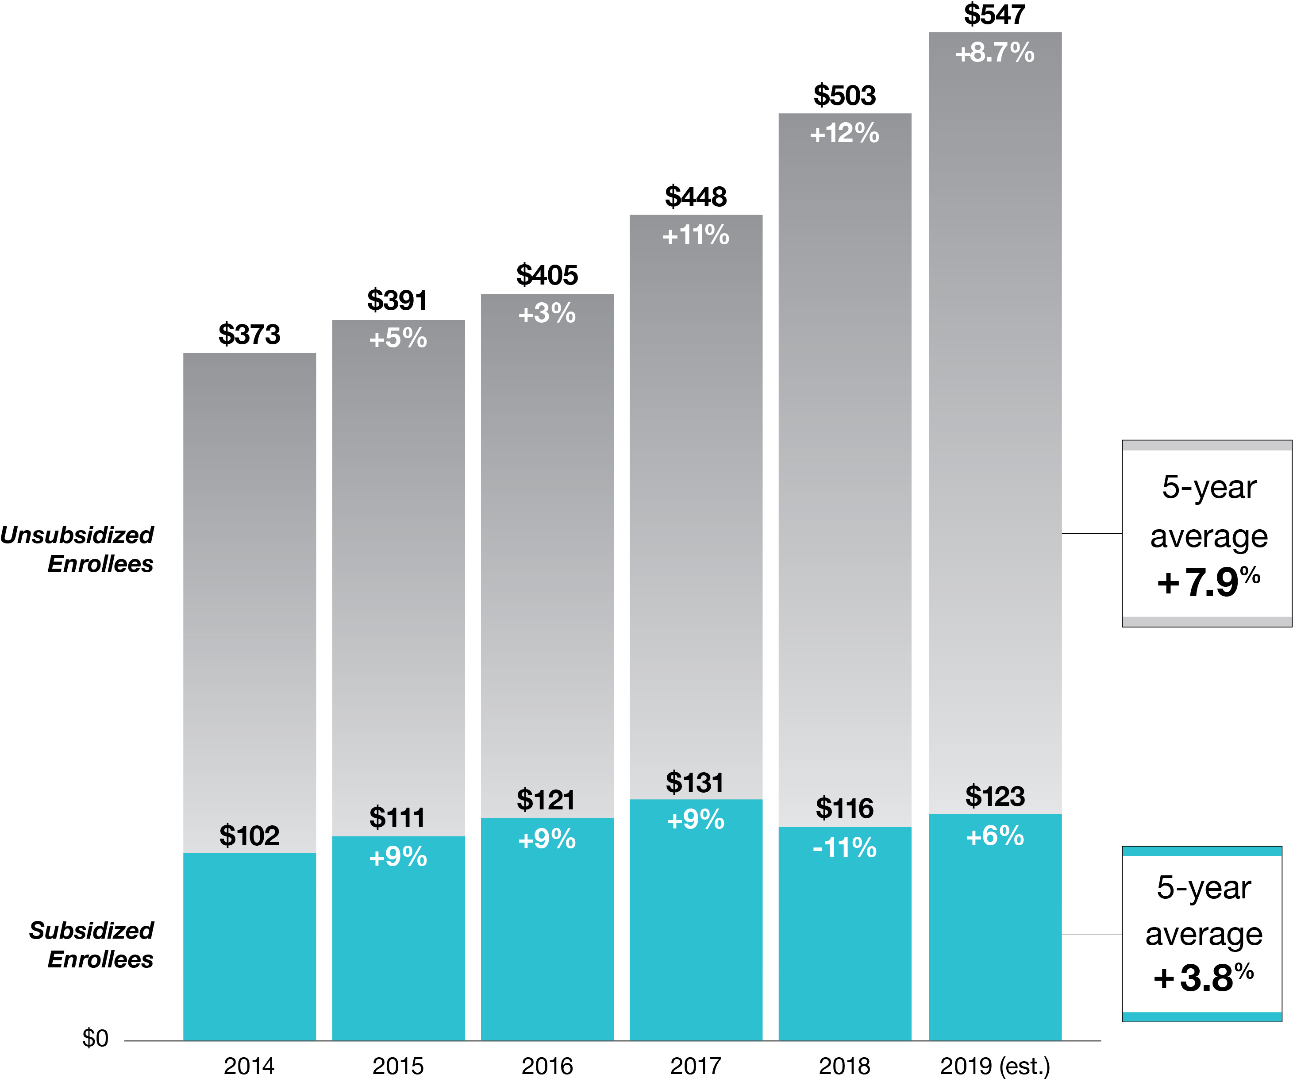
2019 RATES AND OFFERINGS
Over the past five years, Covered California has held average annual rate changes for unsubsidized consumers to an estimated average of 7.9 percent and 3.8 percent for subsidized consumers
Premiums shown are the actual observed average premiums in Covered California administrative data for renewal and open-enrollment plan selections for plan years 2014 through 2018, and the percentage change is the change to the average observed premiums. Year over year, the average premiums shown may be influenced by changes in the population distributions (such as for region, age, metal tier, etc.). Average premiums for the off-exchange market as a whole could differ from the Covered California unsubsidized premiums to the extent that the off-exchange population and plan-choice profiles differ from the on-exchange, unsubsidized profile. Additionally, the 2018 unsubsidized premiums have been adjusted to remove the cost-sharing reduction “surcharge” in Silver, since off-exchange enrollees do not incur the surcharge, and Covered California encouraged its unsubsidized Silver enrollees to move off-exchange to avoid the surcharge in 2018. For coverage year 2019 premiums, this chart shows an estimate of what premiums would be if all consumers enrolled in their same 2018 plan for 2019. The chart applies the global weighted Covered California average increase of 8.7 percent to produce the estimated average unsubsidized premium, which is an estimate of what off-exchange enrollees may pay in 2019 (the actual 2019 amount will depend on enrollee take-up and plan choice during renewal and open enrollment).

Slide 7
LOOKING FORWARD TO 2020
Health Equity
  Ensuring the Quality Improvement agenda comprehensively considers health equity, which may include elements beyond the clinical setting, such as social determinants of health.
Benefit Designs
  “Copay only” plan
  Possibility of regional pilots for Value Based Insurance Design (VBID)
  Continue to evaluate the potential for “funded” HSAs
2020 Certification Process
2020 - 2022 QHP and QDP Contracts

Slide 8
Covered California personnel & strategy update
TERRI CONVEY, DIRECTOR
SALES AND OUTREACH DIVISION
JAMES DEBENEDETTI, DIRECTOR
PLAN MANAGEMENT DIVISION
TAYLOR PRIESTLEY, HEALTH EQUITY OFFICE
PLAN MANAGEMENT DIVISION

Slide 9

OUTREACH AND SALES DIVISION
The team
Programs
We work with
60 Associates
Field services
Distribution services
Navigator Program
Covered California for Small Business
13,867 Certified Insurance Agents
1,014 Navigators
1,615 Certified Application Counselors
591 Plan based enrollers
23 Medi-Cal enrollers

Slide 10
APPROACH TO 0E6
Stay on message
- Power of progress
- Worst uninsured rate in nation to <4% uninsured
- Real people stories
Focus on what’s working
- Strong partners and advocates
- In-person assistance
- Storefront program
- Help On Demand
Innovate & Improve
- CalHEERS enhancements
- Pilot programs
- Medi-Cal to Covered.CA process improvement
46%
of consumers enrolled with in-person assister

Slide 11
PLAN MANAGEMENT UPDATES
New Deputy Director: Jan Falzarano
New Health Equity Officer: Taylor Priestley
  Will oversee a new unit focused on Quality, Population Health and Health Equity, Population Care. (Formerly “Quality Team” but being expanded based on Plan Management strategic direction.)
  This team will ensure health equity perspective and priorities to all elements of quality improvement and delivery system reform agenda

Slide 12
PLAN MANAGEMENT: CURRENT STRUCTURE
James DeBenedetti
Director
Jan Falzarano
Deputy Director
Lance Lang
Chief Medical Officer
Issuer Engagement
Pam Power
Manager
Contracts
Elise Dickinson
Manager
Population Care
Taylor Priestley
Health Equity Officer
Analytics and Informatics
Kristi Downer
Interim Lead
Plan Managers are liaisons between Covered California and health and dental plan issuers, ensuring daily formal and informal communication and problem solving.
Coordinate with other divisions, agencies and organizations related to health plan issue resolution.
Attachment 7 & Quality Improvement Strategy (QIS), and other quality-related work.
Health Equity (will be infused into new work agenda).
Consumer decision making tools (i.e. provider directory).
Engagement with external organizations related to delivery system improvement and population care.
Assess and analyze health and dental plan data including premiums, service area, enrollment, networks and provider directory.
Benefit design development.
Market research and comparison of benefit designs, pricing, and enrollment.
Health and dental issuer contract management for individual and CCSB markets.
Certification Management for QHP and QDP, Individual and CCSB markets.
Vendor contracts.
Managing audit issues related to Plan Management.

Slide 13
PLAN MANAGEMENT UPDATES: HEALTH EQUITY
Creating a new team combining Senior Quality Specialists and new positions dedicated to health equity and social determinants of health
  Initial phase: revising existing roles and responsibilities
  Future hiring for new positions based on health equity agenda
Engaging in internal and external research and discussions to draft health equity agenda strategic plan

Slide 14
DENTAL RESEARCH: PROVIDER QUALITY AND RISK ASSESSMENT
MURIEL LAMOIS, QUALITY ANALYST INTERN & MPH CANDIDATE
EMILY POLK, QUALITY ANALYST INTERN & MPH CANDIDATE
PLAN MANAGEMENT DIVISION

Slide 15
IDENTIFYING AND ENCOURAGING USE OF HIGH PERFORMING DENTAL PROVIDERS
Muriel LaMois, Quality Analyst Intern

Slide 16
GOAL
How can you meaningfully collect and utilize quality measurements to identify and encourage use of high-performing dental providers?
And
How can you encourage enrollee selection of a primary care dentist and promote the use of a dental home to establish long-term, regular, comprehensive dental care from a high performing provider

Slide 17
LIMITATIONS IN MEASURING QUALITY IN DENTAL CARE
Lack of diagnostic codes
  Rely on utilization and claims data
  Difficult to assess appropriateness of care
Quality assessment mainly focused on compliance
  Systems and requirements in place for safety and licensure
  Difficult to assess degrees of quality within compliant providers
Patient satisfaction is highly subjective
  Most commonly reported method of quality measurement
  Can skew negative
Lack of objective quality measures
  Dental Quality Alliance most commonly used set of measures
  Approved first set of measures for adult population in 2016, three quality measures

Slide 18




ENSURING NETWORK QUALITY
How do you incentivize or reward high-performing providers?
Objective Quality Measures
Promote use of high-performing providers
Move from fee-for-service to pay-for-performance
Enable providers to focus on preventative care

Slide 19
THE DENTAL HOME MODEL
Key components of a dental home:
Access to care
Quality of care
Coordination of care
Continuous care
Provision of preventive care, including risk assessment
Ideally, dental home concept should reflect a team approach that includes dental hygienists, primary care health professionals, community-based health providers, and families

Slide 20
CURRENT DENTAL HOME INITIATIVES
Pilots showing impact in improving utilization and cost savings:
Initiatives in 9 states and the Department of Health and Human Services
DentaQuest’s TennCare: 100% enrollees are assigned to a patient-centered dental home
  Members able to get routine appointment 8 days sooner; emergency care 11 hours earlier
  Program has saved Tennessee $27.5 million in Medicaid costs
Other dental home initiatives:
The ADA’s Community Dental Health Coordinator (CDHC) Pilot
Virtual Dental Homes
Most focus on connecting low-income women and children to dental care

Slide 21
Barriers
Coordination of Care
Potential for cost savings
Reconciling both business models
Dentists as part of the patient’s coordinated care team
Referrals between medical and dental
No efficient way to share data
Non-compatible EHR systems
Cost prohibitive
Diagnostic codes
Continuous / Preventative Care
Patient Perspective
Fear of dentist
Low value of preventative services
Virtual Dental Homes
Increased access to screenings and cleanings
Mixed results on patient follow up for additional care
Incentivizing Preventative Care
Feasibility as a business model
Quality measures, pay for performance

Slide 22
HOW CAN COVERED CALIFORNIA HELP
Better quality measures
Improve system integration
Increase outreach
Standardized quality measures
Emphasize importance of integration
Motivate engagement, inter-professional training
Consider cost of implementation
Preventative care ad campaign
Permission around provider outreach to new members
Risk Assessment

Slide 23
DENTAL RISK ASSESSMENT:
IDENTIFYING AND MANAGING AT-RISK ENROLLEES
Emily Polk, Quality Analyst Intern
Plan Management Division

Slide 24
PROJECT GOALS
Inform Covered California dental quality agenda, focusing on:
What are the existing definitions for “at-risk enrollees”?
What are the current ways issuers identify and proactively manage at-risk enrollees?
What are current methods to identify member health status including chronic conditions?
Where is this field heading?

Slide 25
WHAT DO WE MEAN BY “AT RISK” ENROLLEES?
The QDP Issuer Model Contract defines “at risk” enrollees as:
Enrollees with existing and newly diagnosed need for dental treatment and those who are most likely to benefit from well-coordinated care

Slide 26
WHY DO WE CARE ABOUT RISK?
Oral health impacts general health, and vice versa
  Smokers, pregnant women, and those with diabetes and other chronic and acute conditions are at increased risk.
  Oral diseases and disorders affect health and well-being throughout life.
Identifying and managing those who are at-risk for needing dental care not only improves member oral health but improves general health as well
Unmet need:
  23% of children¹ and 26% of adults² have untreated tooth decay
  Disparities by race/ethnicity and income
Ultimately, our goal is to prevent disease and improve enrollee oral and general health
1) https://www.nidcr.nih.gov/research/data-statistics/dental-caries/adults
2) https://www.nidcr.nih.gov/research/data-statistics/dental-caries/children

Slide 27
DENTAL RISK IS MEASURED AT THREE LEVELS
Plan level:
Analysis of claims/encounter data
Provider level:
Caries Risk Assessment or other clinical risk assessment
Enrollee level:
Self-assessment through Oral Health Risk Assessment
At each level, how can enrollee health be factored in to risk assessment?

Slide 28
KEY OPPORTUNITIES TO IMPROVE RISK ASSESSMENT AT EACH LEVEL
Enrollee level assessment:
Self-assessment through Oral Health Risk Assessment
Barriers
Opportunities
Collecting OHRA results to target member outreach based on risk
Covered California directing members to complete Oral Health Risk Assessment tools after dental enrollment
Low incentive for enrollee to use complete assessment tool
Does not replace clinical assessment

Slide 29
KEY OPPORTUNITIES TO IMPROVE RISK ASSESSMENT AT EACH LEVEL
Provider level assessment:
Caries Risk Assessment or other clinical risk assessment
Barriers
Inconsistent tools
Opportunities
Promotion of a standardized Caries Risk Assessment tool
Dental education
Organizational Culture
Universal reimbursement for Caries Risk Assessment
Enhanced benefit package based on level of risk

Slide 30
KEY OPPORTUNITIES TO IMPROVE RISK ASSESSMENT AT EACH LEVEL
Plan level assessment:
Analysis of risk based on claims/encounter data
Barriers
Incomplete data received by plans
Lack of medical/dental integration
Lack of diagnostic codes
Opportunities
Integration between health and dental plan data to identify high-risk members and target outreach
Supporting the movement towards requiring diagnostic codes

Slide 31
NEXT STEPS: DENTAL TECHNICAL WORKGROUP DISCUSSIONS
Potential Standardization
  Definitions
  Risk Assessment Tools
  Quality and Performance Measurement
Outreach and Education Opportunities
  Availability and importance of no-cost preventive and diagnostic care
  Importance of dental care for members with certain health conditions or risk factors
  Importance of completing health risk assessments
  How to choose a dentist
Medical and Dental Integration Opportunities
  Enhanced Benefit Design
  Information Sharing
  Care Coordination
All discussions must include consideration of legal and technical challenges, cost and administrative burden to plans and providers, and consumer impacts.

Slide 32
Plan advisory scope and WORK GROUP focus areas
ROB SPECTOR, CHAIR
PLAN MANAGEMENT ADVISORY GROUP

Slide 33
ADDRESSING ADDITIONAL TOPICS/PROGRAMS RELATED
TO PLAN MANAGEMENT
By leveraging work groups, several topics / programs could be addressed through the Plan Advisory model – similar to the Benefit Design Work Group
Working sessions to create a “roll up your sleeves” environment for stakeholder collaboration
Report out to the Plan Management & Delivery System Reform Advisory Group
Work group composition would vary and not all would be staffed by Plan Management
Plan Management & Delivery System Reform Advisory Group
Work Group: Benefit Design
Work Group: TBD

Slide 34
POTENTIAL DOMAINS FOR WORK GROUPS OR ADVISORY TOPICS
Plan Management & Delivery System Reform Advisory Group
Benefit Design*
Dental*
CCSB*
Health Equity & Quality
Marketing, Sales & Outreach Advisory Group*
Access and Cost of Care
  *Existing / Previous Advisory Group
  PMD will follow up with a survey through our stakeholder distribution list. To be added please contact Gina.Uybungco@covered.ca.gov

Slide 35
ACCESS AND COST OF HEALTH CARE WORKGROUP
What Are We Solving For
How Would It Function
Leveraging this forum stakeholders to work together to address “market wide” opportunities to improve access and lowering costs
Addressing certain market wide issues & opportunities
Working group of Plan Management Advisory stakeholders
Reporting from EAS
Identifying actionable insights from the data
Reporting back through Plan Mngt Advisory
Brainstorming and vetting solutions

Slide 36
WHAT THE “REPORT BACK TO PLAN MANAGEMENT” COULD LOOK LIKE FOR ACCESS AND COST OF HEALTH CARE WORKGROUP
Access & Cost Opportunity (from data)
Actionable Insights (from research, stakeholder experience & clicking into the data)
Ideas on How to Address (from stakeholder brainstorming / vetting)
X% of children are below benchmarks for utilizing dental or vision services
Low awareness of covered services
Produce standard messaging / campaign on accessing dental services – pushed through community partners, QHPs, and CC marketing
More prevalent in [metal tier, region, demographic, etc]
Consider partnering with [external collation / association]
TBD
Illustrative Example

Slide 37
OPEN FORUM AND NEXT STEPS
ROB SPECTOR, CHAIR
PLAN MANAGEMENT ADVISORY GROUP

Slide 38
OPEN FORUM ITEMS
Benefit Design Work Group will likely start in September. If interested email Allie.Mangiaracino@covered.ca.gov.
New C-Section Consumer Resource: “My Birth Matters” is designed to educate women about the overuse of C-sections and encourage them to engage with their care team to reduce chances of having an avoidable C-section. It is aligned with QHP maternal safety work. Please spread the work through your organizations!
  More information: https://www.cmqcc.org/news/my-birth-matters-c-section-consumer-education-campaign-launches.

